Slide 1
IB computer science
Sorting Algorithms:
Insertion Sort
Selection Sort
Bubble Sort
Merge Sort
Wu Di
武迪
Oct, 2016
Notes:
Good morning everyone, let’s first give a warm welcome to our distinguished guests for joining our lesson this early morning.
Today we are going to explore an interesting topic in computer science: the sorting algorithms.

Slide 2

3 Basic Algorithms: Insertion
// Arr: An Array which is one-based
N = LENGTH(Arr)
FOR i = 2 TO N
CurValue = Arr[i]
j = i
WHILE j > 1 AND CurValue < Arr[j-1]
Arr[j] = Arr[j-1]
j = j -1
ENDWHILE
Arr[j] = CurValue
ENDFOR
6, 5, 3, 1, 8, 7, 2, 4
i = 2
Compare
5, 6, 3, 1, 8, 7, 2, 4
i = 3
3, 5, 6, 1, 8, 7, 2, 4
i = 4
1, 3, 5, 6, 8, 7, 2, 4
i = 5
1, 3, 5, 6, 8, 7, 2, 4
i = 6
1, 3, 5, 6, 7, 8, 2, 4
i = 7
1, 2, 3, 5, 6, 7, 8, 4
i = 8
maintains a sorted sub-array, and repetitively inserts new elements into it
1, 2, 3, 4, 5, 6, 7, 8
Notes:
Let’s warmly welcome group * to come to the stage to give us their acting of insertion sort!
Dear judges, please write down your marks for each group. The score scale is 1-10, 10 is the highest!

Slide 3
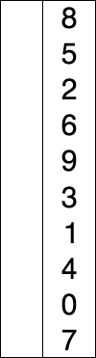
3 Basic Algorithms: Selection
// Arr: An Array which is one-based
N = LENGTH(Arr)
FOR i = 1 TO N-1
MinSub = i
FOR j = i + 1 TO N
IF Arr [j] < Arr [MinSub]
MinSub = j
ENDIF
ENDFOR
Temp = Arr [i]
Arr [i] = Arr [MinSub]
Arr [MinSub] = Temp
ENDFOR
i = 1
8, 5, 2, 6, 9, 3, 1, 4, 0, 7
0, 5, 2, 6, 9, 3, 1, 4, 8, 7
i = 2
0, 1, 2, 6, 9, 3, 5, 4, 8, 7
i = 3
Compare
0, 1, 2, 6, 9, 3, 5, 4, 8, 7
i = 4
0, 1, 2, 3, 9, 6, 5, 4, 8, 7
i = 5
0, 1, 2, 3, 4, 6, 5, 9, 8, 7
i = 6
0, 1, 2, 3, 4, 5, 6, 9, 8, 7
i = 7
0, 1, 2, 3, 4, 5, 6, 9, 8, 7
i = 8
Swap
0, 1, 2, 3, 4, 5, 6, 7, 8, 9
i = 9
0, 1, 2, 3, 4, 5, 6, 7, 8, 9
Red is current min.
Yellow is sorted list.
Blue is current item.
repetitively pick up the smallest element and put it into the right position
Notes:
Fantastic! Now Let’s introduce group * to come on the stage to give us their acting of selection sort!

Slide 4

3 Basic Algorithms: Bubble
// Arr: An Array which is one-based
N = LENGTH(Arr)
FOR i = 1 TO N-1
FOR j = 1 To N-i
IF Arr [j] > Arr [j+1]
Temp = Arr [j]
Arr [j] = Arr [j+1]
Arr [j+1] = Temp
ENDIF
ENDFOR
ENDFOR
i = 1
6, 5, 3, 1, 8, 7, 2, 4
5, 3, 1, 6, 7, 2, 4, 8
Compare
i = 2
3, 1, 5, 6, 2, 4, 7, 8
i = 3
1, 3, 5, 2, 4, 6, 7, 8
Swap
i = 4
1, 3, 2, 4, 5, 6, 7, 8
i = 5
1, 2, 3, 4, 5, 6, 7, 8
i = 6
1, 2, 3, 4, 5, 6, 7, 8
i = 7
1, 2, 3, 4, 5, 6, 7, 8
repetitively compares adjacent pairs of elements and swaps if necessary
Notes:
Wonderful! Now The stage is all yours, group *, please give us your talented acting of bubble sort!

Slide 5
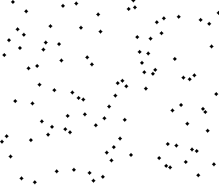


Summary: 3 Basic Algorithms
A
B
C
Insertion Sort
maintains a sorted sub-array, and repetitively inserts new elements into it
Selection Sort
repetitively pick up the smallest element and put it into the right position
Bubble Sort
repetitively compares adjacent pairs of elements and swaps if necessary
Notes:
Great, we’ve applied the 3 sorting algorithms to an interesting role playing game!
Now, Let’s summarize our first period with a small quiz: Link animation A,B,C to the correct sort algorithm.
Anyone would like to come to the front to be the student teacher to finish our 1st period with this recap question? You can ask other students to answer your questions and conclude with your own words and understanding!

Slide 6
Lesson Orientation
What?
Introduction
Sorting Algorithm
Link with real world cases
Why?
Applications
3 Basic Algorithms
What?
Cooperative Learning
Group Acting
Algorithm
Insertion Sort
Selection Sort
Bubble Sort
How?
Implementation
Reciprocal Learning
Practical Programming
Analysis
Performances
Practical Exploration
Extension Research
Notes:
Thank you so much for your wonderful performance so far. Take a short break, and we are going to implement the 3 sorting algorithms in the next period.

Slide 7
Implementation
Open you Python IDE
Download the code template from our wiki:
Home: 5. Topics and materials:
Sorting Algorithms: insertion, selection, bubble and merge sort
2: The code: 3 basic algorithms for you to complete (with pseudocode added)
Try to complete the core part of each algorithm
Insertion
Selection
Bubble
Test your algorithms
Submit your code to your wiki project page

Slide 8
Lesson Orientation
What?
Introduction
Sorting Algorithm
Why?
Link with real world cases
Applications
3 Basic Algorithms
What?
Cooperative Learning
Group Acting
Algorithm
Insertion Sort
Selection Sort
Bubble Sort
How?
Implementation
Reciprocal Learning
Practical Programming
Analysis
Performances
Practical Exploration
Extension Research
Notes:
Now it’s time for our final subtopic for this lesson. How to analyze the performance of the algorithm? Like how fast, how much memory resources it will take? Etc.

Slide 9
Performance Analysis
In terms of the size of the array(N): Big O notation -$O(f(N))$
Computational complexity Time usage |  | Space complexity Memory usage
Comparison | Swaps
Insertion
Selection
Bubble
Notes:
For an array of size N, we want to know how much time a sorting algorithm will take to sort it into a certain order. This is the computational complexity, which is function of the array size N. In computer science, it is usually represented using the big O notation.
Besides time, we also want to know how much space a sorting algorithm will need. It is also a function of array size N, and usually be represented with Big O notation.
Further more, we might want to know if a sorting algorithm is stable or not.
http://en.wikipedia.org/wiki/Sorting_algorithm

Slide 10
Implementation
Run your algorithms with different scales of input
See how the running time varies with increasing data input
Plot the Running Time v.s. N (number of input data) graph

Slide 11
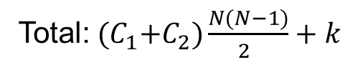
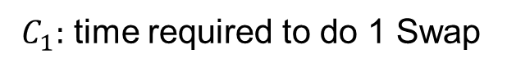
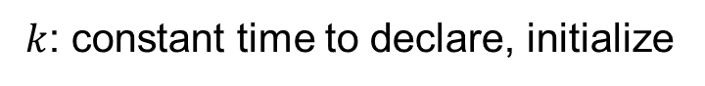
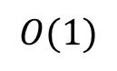
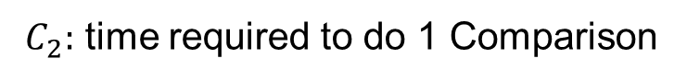
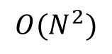
Performance Analysis: Bubble
Outer loop 1
Array size: N
Inner loop: N-1 Comparison
N = LENGTH(Arr)
FOR i = 1 TO N-1
FOR j = 1 To N-i
IF Arr [j] > Arr [j+1]
Temp = Arr [j]
Arr [j] = Arr [j+1]
Arr [j+1] = Temp
ENDIF
ENDFOR
ENDFOR
N-1 Swap
Outer loop 2
Inner loop: N-2 Comparison
Compare
N-2 Swap
Outer loop N-i
Inner loop: i Comparison
Swap
i Swap
$C_{1}:$ time required to do 1 Swap
$C_{2}:$ time required to do 1 Comparison
$k$: constant time to declare, initialize
Swap:${ C}_{1}\left(\left(N−1\right)+\left(N−2\right)+ …+1\right)=C_{1}\frac{N(N−1)}{2 }$
Memory usage
Comparison: $C_{2}\left(\left(N−1\right)+\left(N−2\right)+ …+1\right)=C_{2}\frac{N(N−1)}{2 }$
In place
N,i,j,Temp
Total:${ (C}_{1}+C_{2})\frac{N(N−1)}{2 }+k$
$$O(1)$$
$$O(N^{2})$$
Notes:
Let’s see how to calculate the computational complexity. The most time consuming steps in the algorithm are comparing and swapping. Here, we take the bubble sort algorithm for an example to calculate the total number of swaps and comparisons as a function of size N.
In outer loop 1, there are N-1 comparison and N-1 swaps, in outer loop 2, there are N-2 comparisons and N-2 swaps, in outer loop I, there are N-I comparisons and swaps.
So the total numbers of swap and comparison is a simple sum of arithmetic sequence, which equals to half of N times N-1. If the time takes to do a swap is C1, and time takes to do a comparison is C2, then the total time is this, it is a quadratic function of N. So we represent the computational complexity as big O, N squared.
About the memory usage, because we swap the array element, which means directly use the memory for storing arrays, no additional space is needed to store the array element, this is called in place. In the algorithm, there are several variables for loop control and temporary swap, but they are of fixed number, not related to the array size N. So in sum, the memory usage of the bubble sort is constant, it will not increased with the array size. So we represent it as Big O 1.

Slide 12
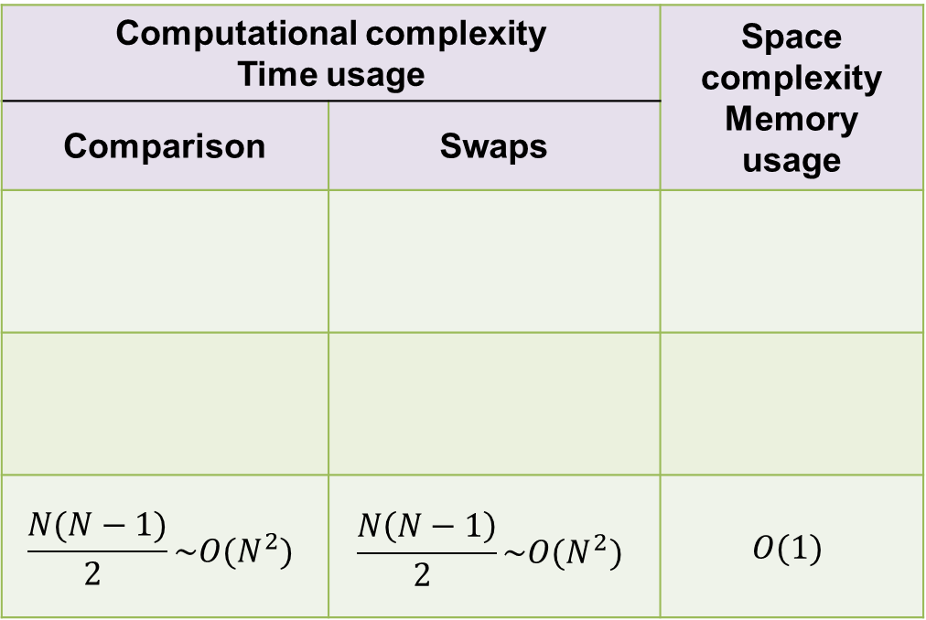
Performance Analysis
In terms of the size of the array(N): Big O notation -$O(f(N))$
Computational complexity Time usage |  | Space complexity Memory usage
Comparison | Swaps
$$\frac{N(N−1)}{2 }\sim O(N^{2})$$ | $$\frac{N\left(N−1\right)}{2 }\sim O(N^{2})$$ | $$O(1)$$
Insertion
Selection
Bubble
Homework
Based on the analysis of bubble sort →
Complete the comparison table on the handout
Theory Deduction
Notes:
To summarize the performance analysis for bubble sort: It’s computational complexity is Big O N squared. While space complexity is Big O 1, and it is a stable algorithm.

Slide 13
Extensions
How to improve the 3 basic algorithms: Insertion, Selection, Bubble?
Algorithm
Implementation
Performance
Shell Sort
Heap Sort
Merge Sort
Quick Sort
……
http://en.wikipedia.org/wiki/Sorting_algorithm
Notes:
Well, as you can see, the 3 basic algorithms we’ve discussed in this lesson is very basic, and in someway not very efficient.
Can you think of the ways to improve the basic algorithms?
As sorting is so important, computer scientists have built more and more efficient algorithms, like shell sort, heap sort, merge sort, quick sort etc….
And this is your optional homework to do some research about these more advanced algorithm.

Slide 14
Lesson Orientation
What?
Introduction
Sorting Algorithm
Why?
Link with real world cases
Applications
3 Basic Algorithms
What?
Cooperative Learning
Group Acting
Algorithm
Insertion Sort
Selection Sort
Bubble Sort
How?
Implementation
Reciprocal Learning
Practical Programming
Analysis
Performances
Practical Exploration
Extension Research
Merge Sort

Slide 15

Merge sort
What is merging?
Given two sorted list
How to combine them into one sorted list?

Slide 16
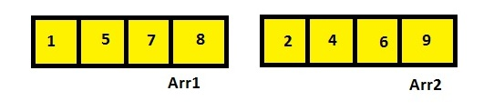
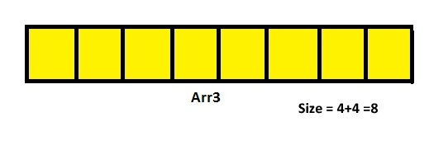
Merge sort
What is merging?
Given two sorted list
How to combine them into one sorted list?
Notes:
http://www.codeproject.com/Articles/805587/Merge-Sort

Slide 17
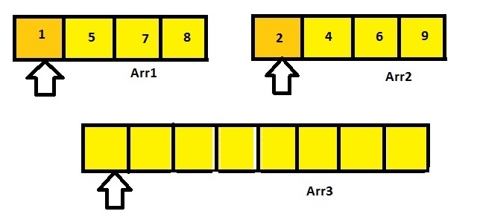
Merge sort
Notes:
http://www.codeproject.com/Articles/805587/Merge-Sort

Slide 18
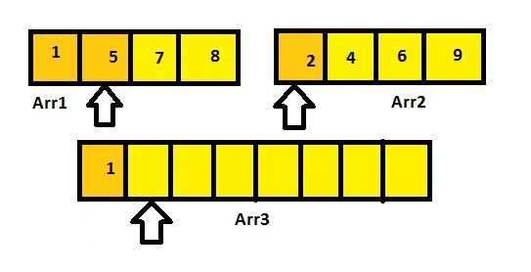
Merge sort

Slide 19
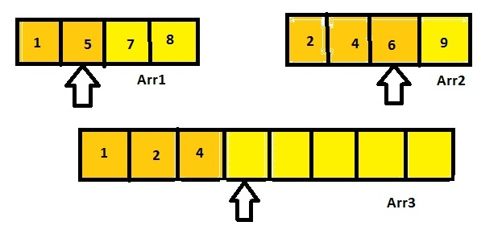
Merge sort

Slide 20
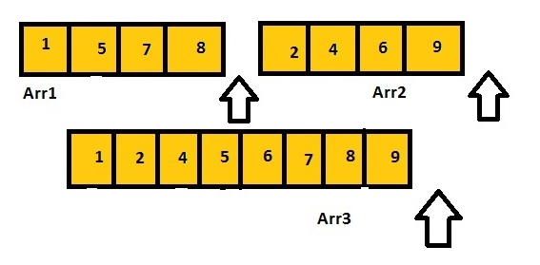
Merge sort

Slide 21
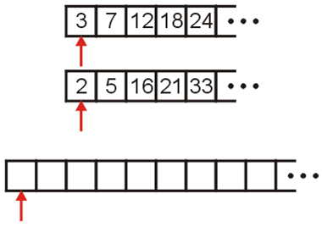
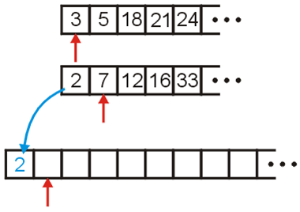
Merge sort
The merging algorithm assumes the two lists are in order.
It creates a third merged list from the two original lists.
We keep picking the smallest element and move it to a temporary array, incrementing the corresponding indices.
We define three references at the front of each array
Notes:
https://www.cs.cmu.edu/~adamchik/15-121/lectures/Sorting%20Algorithms/sorting.html

Slide 22
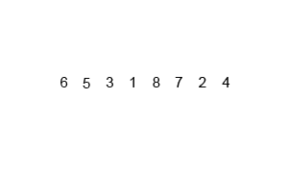
Merge sort
Merge sort: divide and conquer
O(n log n)
if n = 1 ,done
recursively sort A(1,n/2)and A(n/2+1,n)
merge the two sort list
MERGE_SORT( A, low, high )
if low < high then
mid = ( low+high )/2
MERGE_SORT( A, low, mid )
MERGE_SORT( A, mid+1, high )-
MERGE( A, low, mid, mid+1, high )
END MERGE_SORT
Notes:
https://www.cs.cmu.edu/~adamchik/15-121/lectures/Sorting%20Algorithms/sorting.html

Slide 23
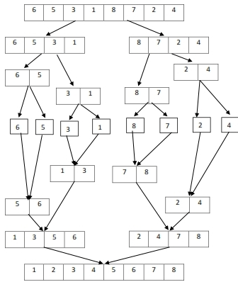

Slide 24
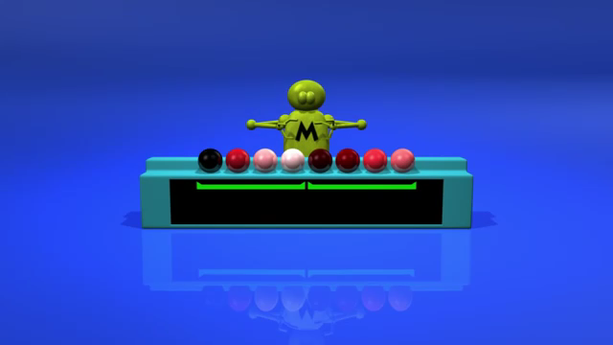
Merge sort

Slide 25
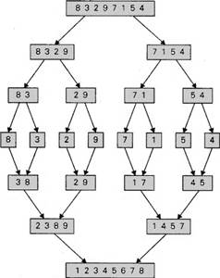
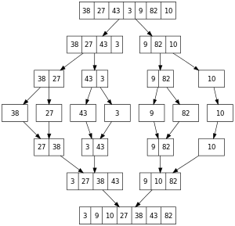
Merge sort
Merge sort: divide and conquer
O(n log n)
Notes:
https://www.cs.cmu.edu/~adamchik/15-121/lectures/Sorting%20Algorithms/sorting.html

Slide 26
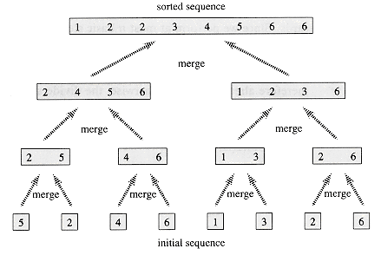
Merge sort
Merge sort: divide and conquer
O(n log n)
Notes:
https://www.cs.cmu.edu/~adamchik/15-121/lectures/Sorting%20Algorithms/sorting.html

Slide 27
Merge sort
http://interactivepython.org/runestone/static/pythonds/SortSearch/TheMergeSort.html
Step by step running

Slide 28
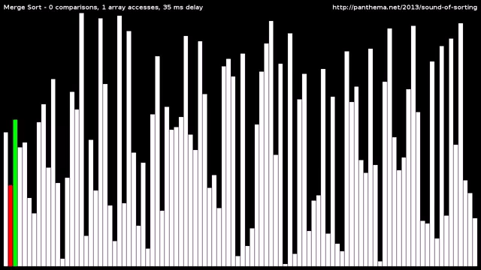
Merge sort

Slide 29
Homework
Complete your handout: exercises
Implement and test each algorithm by yourself, especially the merge sort. Think about recursion.
Compare the time complexity of the introduced 4 algorithms, try to plot the running time v.s. Data scale figure using matplotlib

Slide 30
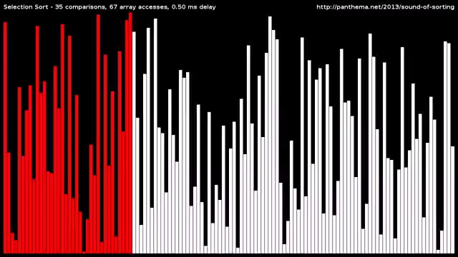
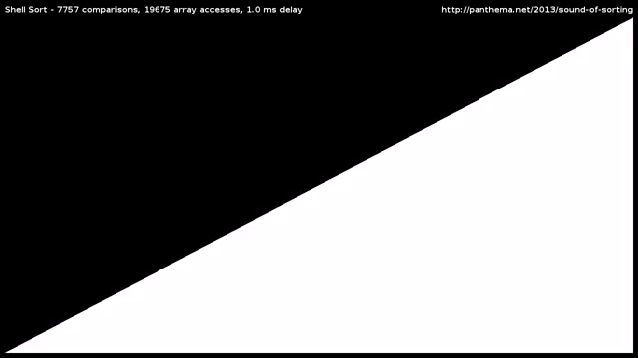
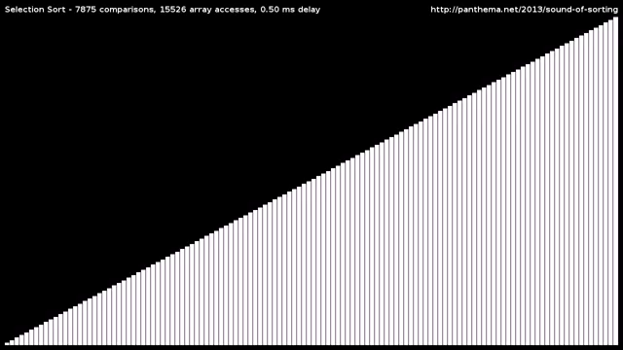
Thank you very much!
Notes:
Thank you so much for all your wonderful and active participation in this lesson.
Hope you all gain certain computational thinkings from the sorting algorithms.
See you next week!

Slide 31
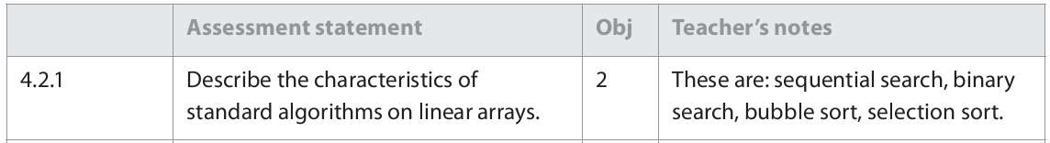
CompSci Guide

